Slide 1
COMP 201 OPEN SOURCE & SYSTEM ADMINISTRATION
DANIEL OBUOBI, DCSIT,CU
SHELL PROGRAMMING

Slide 2
Shell Programming I

Slide 3
Objectives
After studying this lesson, you should be able to:
Learn about shell variables, expressions
Write simple shell scripts to illustrate programming logic

Slide 4
My first Shell Script
Createing a script
vi myfirstscript.csh
#!/bin/csh
set directory=`pwd`
echo The date today is `date`
echo The current directory is $directory
Making a script executable
chmod u+x myfirstscript.csh
Executing a script by name
myfirstscript.csh
It is backquote, not quote.

Slide 5
Using UNIX Shell Scripts
UNIX shell is a command interpreter.
UNIX shell scripts are a group of of shell commands stored into a file for multiple execution.
Everything you can put into a shell script, you can execute by typing them on the command line.

Slide 6
Using UNIX Shell Scripts (Contd)
Shell scripts do not have to be converted into machine language by a compiler.
This is because the UNIX shell acts as an interpreter when reading script files.
After you create a shell script, you simply tell the operating system that the file is a program that can be executed.
This is accomplished by using the chmod command.

Slide 7
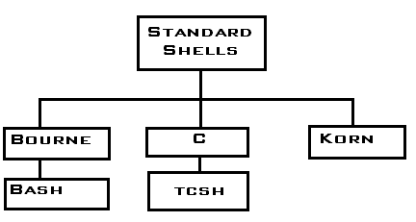
The Programming Shell
Commonly used shell in most variant of UNIX are:
Bourne Shell (sh), first shell developed for UNIX
Bourne Again Shell (bash), written by programmers of Free Software Foundation, open source shell from GNU

Slide 8
The Programming Shell (Contd)
Korn Shell (ksh), written by David Korn, superset of Bourne shell, not widely distributed.
C Shell (csh), written by Bill Joy, the author of vi, shared much of the C language structure.
Terminal Based C Shell (tcsh), enhanced version of the Berkeley UNIX C shell csh

Slide 9
Different types of statements
Comments - Starts with '#' and ends to the end of the line .
The content does not effect the execution of the program with the exception of the first line of the program (#!/bin/csh )
#!/bin/csh forces the current shell to execute a script in the C shell, regardless of your current shell.
Setting and Substituting variable values
Keywords like set, $ and @ indicate that a variable is to be used or set.

Slide 10
Different types of statements (Contd)
Flow-of-control
Keywords like if and foreach are used at the beginning of a line to provide flow control or conditional execution.
Commands to be executed in a new process
If the line does not begin with any substitution or flow-of-control keyword, it is assumed to be a command.
Entire line is scanned in looking for variables to be substituted and wild card characters.
After substitutions the command is executed as it would be from the command line.

Slide 11
Shell Programming
Programming features of the UNIX shell:
Variables
Expressions
Logic structures

Slide 12
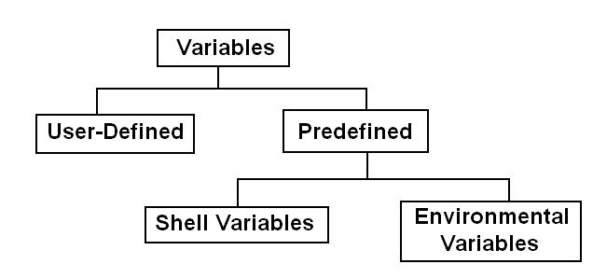
Variables
Variables are symbolic names that represent values stored in memory.
The two classifications of variables are: user-defined and predefined.

Slide 13
Environment Variables
You can use environment variables to customize the environment in which your shell runs.
By convention, environment variables are normally given upper-case names.

Slide 14
Environment Variables (Contd)
To see a list of your environment variables:
printenv
or:
printenv | more

Slide 15
Environment Variables (Contd)
Typical Environment Variables
HOME: pathname of your home directory
PATH: directories where shell is to look for commands
USER: your user name
PWD: your current working directory
TERM: terminal type
SHELL: pathname of your shell
Variable contents are accessed using ‘$’:
echo $HOME

Slide 16
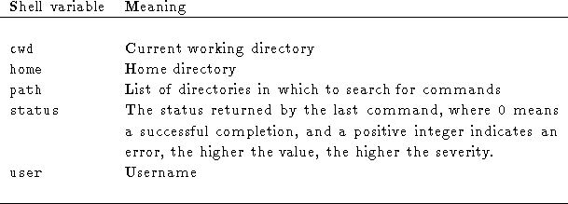
Predefined Shell Variables
The shell copies the environment variable USER into the shell variable user, TERM into term, and HOME into home, and copies each back into the respective environment variable whenever the shell variables are reset.

Slide 17
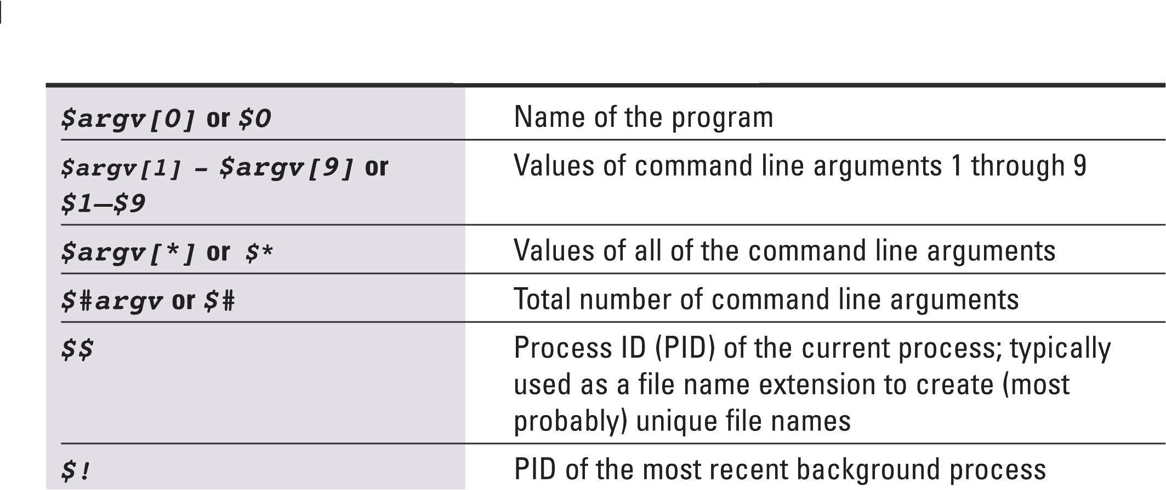
Predefined Shell Variables (Contd)
These variables are most useful for processing command line arguments, the parameters passed to a shell script at the command line.

Slide 18
Predefined Shell Variables (Contd)
vi myinputs.csh
#!/bin/csh
echo Total number of inputs: $#argv
echo First input: $argv[1]
echo Second input: $argv[2]
chmod u+x myinputs.csh
myinputs.csh HUSKER UNL CSE

Slide 19
User-defined Variables
The C shell uses the set statement set variables.
set x = 37
When using a shell variable, a dollar sign ($) must be prepended.
echo $x
With no arguments, set displays the values of all shell variables.

Slide 20
User-defined Variables (Contd)
To create lists:
set Y = (UNL 123 CS251)
To view a list element:
echo $Y[2]
To reset a list element:
set Y[2] = HUSKER
Notes:
If the values include spaces, it must be inside the parentheses.
You can access a list element by list name with index.
Can anyone tell me the output of echo $Y[2]

Slide 21
Command Substitution
When a command is enclosed in backquotes, it is performed by the shell and its standard output replaces the backquoted string.
Example:
set mydir=`pwd`
echo $mydir
The output of the pwd command is assigned to the mydir variable.

Slide 22
setenv: Exporting Environment
Shell scripts cannot automatically access variables created on the command line or by other shell scripts. To make a variable available to a shell script, you must use the setenv command to make it an environment variable.
setenv [VAR [word ] ]
setenv sets the environment variable ‘VAR’ to the value word, which must be either a single word or a quoted string.

Slide 23
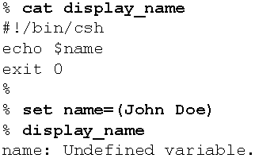

setenv Example
In the left session, the name variables declared is not exported before running the script, and the name variable used in the script is local to the script. As this local variable name is uninitiated, the echo command displays the error message.
In the right session, the name variable is exported after it has been initialized, thus making it available to the display_name script.

Slide 24
Resetting Variables
You can remove a variable from the environment by using the unset and unsetenv commands.
unset variable
unsetenv variable

Slide 25
Reading from Standard Input
set variable = $< or
set variable = `head -1`
Read one line from stdin into ‘variable’
Sample script:
#! /bin/csh
echo -n "Give the size: "
set size = $<
echo " Your input is $size"

Slide 26
Shell Programming
Programming features of the UNIX shell:
Variables
Expressions
Logic structures

Slide 27
Expressions
An expression is a group of words (numbers, strings, and operators separated by spaces) which the C shell replaces by a single number, called its value. Expressions are only evaluated in conjunction with four built-in commands:
if (expression) then
while (expression)
exit (expression)
@ name = (expression)
The if, while and exit use expressions with a common syntax, and the @ has its own separate syntax.

Slide 28
Expressions (Contd)
The if and while statements use the value of expression to determine whether to execute the next command or group of commands.
The @ command stores the value of expression in the variable name. Except for providing the only way to store the results of an arithmetic or logic computation, it is identical to the "set" command.
The exit command quits the current shell (e.g., in a script) and sets the command completion status (which other programs sometimes want to know) with the value of expression.

Slide 29
Expressions (Contd)
The C shell has two main kinds of expressions: arithmetic and logic.
Of logic expressions it has three kinds: boolean, file enquiry, and command status enquiry.

Slide 30

Arithmetic Expressions
Evaluation simply means doing the arithmetic indicated, and the value that replaces the expression is just the result. You may use any of the operators and precedences valid in the C programming language, e.g. +, -, *, /, % (remainder).
set y = 8 ; set num = (4 168 10 8808)

Slide 31
Arithmetic Expression Examples
Space is needed.
Space is needed.
% @ z = (3 + 4)
% echo Result is $z
Result is 7
% @ x = (354 - 128)
% echo Result is $x
Result is 226
% set y = (354 - 128)
% echo Result is $y
Result is 354 - 128
Space is needed.
Notes:
Can you see the difference? @ command is the only way to store the computation result.

Slide 32
Logic Expressions
Evaluation means asking the question "Is it true that expression?", where expression is a statement or assertion phrased in C Shell terms. The value replacing it is 1 if the statement is true, 0 if false.
Any nonzero valued expression is taken as true, whatever you may have intended. E.g.,
(3 + 2) is both 5 and true.

Slide 33

Boolean Expressions
These expressions make assertions about the relative sizes of two numbers.
There are 8 kinds of assertions,
Two ways to combine two assertions,
One way to negate an assertion
Notes:
Just tell =~ is regular expression equals, !~ (exclamation tilda) means …
We have learn it in awk (&&, ||)

Slide 34

Boolean Expression Examples
Here are some examples:
set y = 8 ; set num = (4 168 10 8808)
% set x = 340
% if ($x > 200) echo You cannot afford it. You cannot afford it.
Notes:
Why (2 == $y || 3>2) is 1
Why (prog.c == *.c) is 0
Why (prog.c =~ *.c) is 1

Slide 35
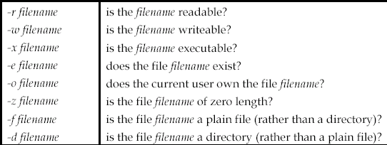
File Enquiry Expressions
These have the form (-L filename), where the L specifies one of 8 different assertions about filename. The possible choices for L are:

Slide 36
File Enquiry Expressions Examples
Expression Meaning
if (-f $argv[1]) If the first argument is a plain file
if (! -d $tmpdir) If tmpdir is not a directory
if ($file !~ *.[zZ]) If the file doesn't end with .z or .Z

Slide 37
Command Status Expressions
These have the form ( { command } ), where the shell executes command during evaluation, and uses the completion status as the value of the variable.
Note the spaces between command and the {}'s.
An example:
To leave a script and let the calling process know of a match for a string in a file
exit ( { grep -s string file } )

Slide 38
Shell Programming
Programming features of the UNIX shell:
Variables
Expressions
Logic structures

Slide 39
C Shell Logic Structures
if-then-else-endif
foreach
while
switch
break, continue, goto

Slide 40
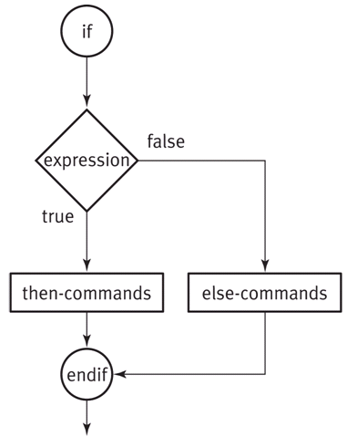
if-then-else-endif
1. if ( expr ) simple-command
2. if (expr) then
then-commands
endif
3. if ( expr ) then
then-commands
else
else-commands
endif

Slide 41
if-then-else-endif (Contd)
4. if ( expr1 ) then
then-commands
else if (expr2) then
else-if-1-commands
else if (expr3) then
else-if-2-commands
…
else
else-commands
endif

Slide 42
if-then-else-endif Example
A simple example
#!/bin/csh
if ($#argv != 2) then
echo $0 needs two parameters!
echo You are inputting $#argv parameters.
else
set par1 = $argv[1]
set par2 = $argv[2]
endif

Slide 43
if-then-else-endif Example
Another example:
#!/bin/csh
# number is positive, zero or negative
echo "enter a number:"
set number = $<
if ( $number < 0 ) then
echo negative
else if ( $number == 0 ) then
echo zero
else
echo positive
endif

Slide 44
if-then-else-endif Example
Another example:
#!/bin/csh
if {( grep UNIX $argv[1])} then
echo UNIX occurs in $argv[1]
else
echo No!
echo UNIX does not occur in $argv[1]
endif

Slide 45
C Shell Logic Structures
if-then-else-endif
foreach
while
switch
break, continue, goto

Slide 46
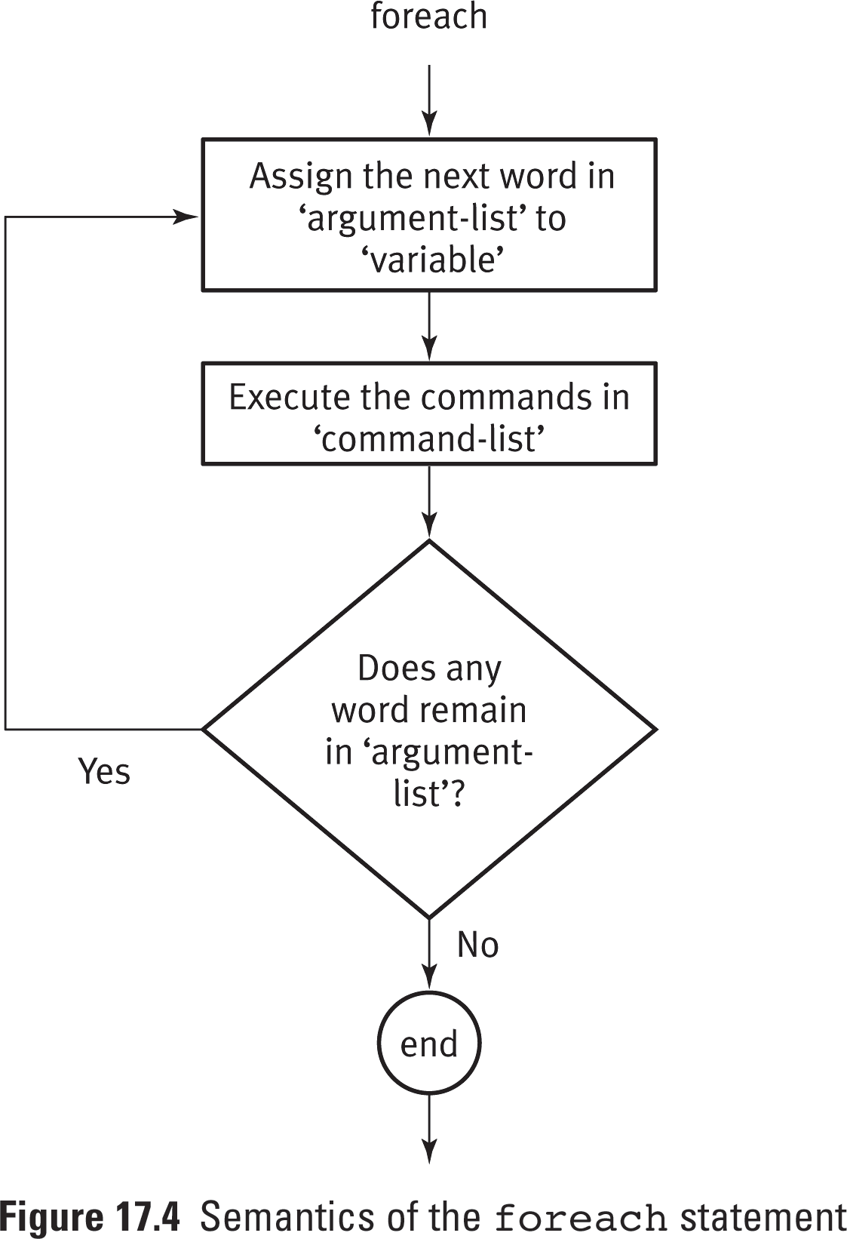
foreach
foreach var (argument-list)
command-list
end
looping through a range of values

Slide 47
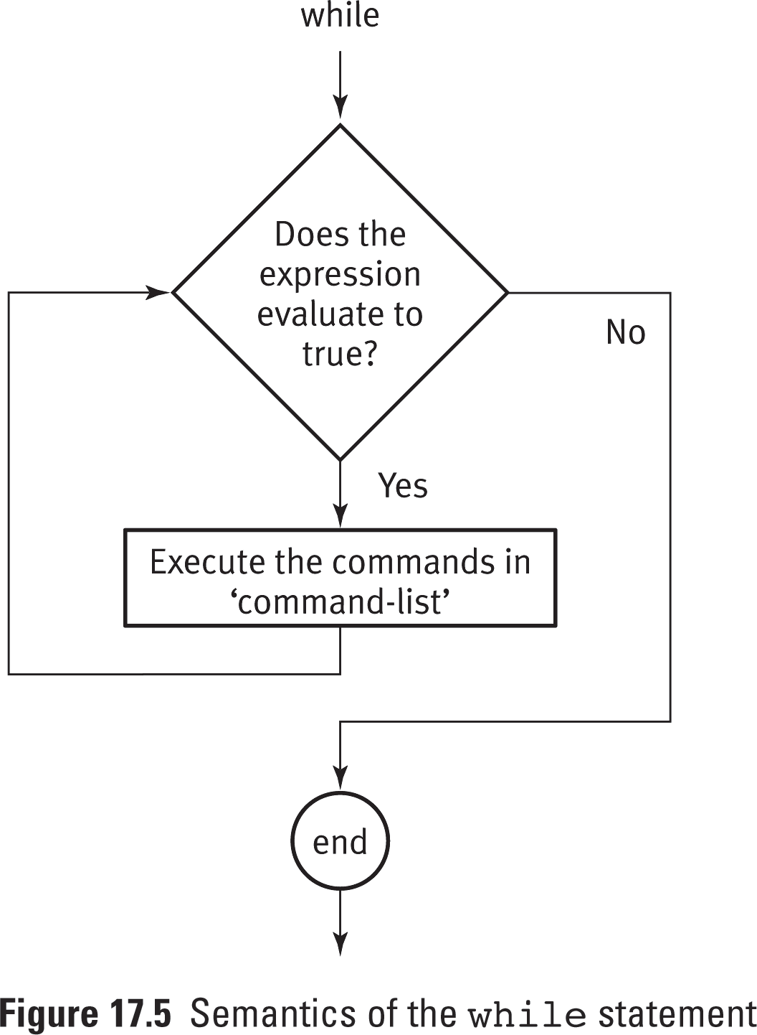
while
while (expr)
command-list
end
The while statement best illustrates
how to set up a loop to test
repeatedly for a matching condition.

Slide 48
foreach Example
Program:
#!/bin/csh
foreach person (Bob Susan Joe Gerry)
echo Hello $person
end
Output:
Hello Bob
Hello Susan
Hello Joe
Hello Gerry

Slide 49
foreach Example
Program: an example using $* to process a list of files
#!/bin/csh
foreach file ($*)
cp –r $file $file.bak
end

Slide 50
while Example
Adding integers from 1 to 10
#!/bin/csh
set i=1
set sum=0
while ($i <= 10)
echo Adding $i into the sum.
@ sum= $sum + $i
@ i= $i + 1
end
echo The sum is $sum.

Slide 51
Switch Logic
The switch logic structure simplifies the selection of a match when you have a list of choices.
It allows your program to perform one of many actions, depending upon the value of a variable.

Slide 52
Switch Logic
switch ( test-string )
case pattern1:
command_set_1
breaksw
case pattern2:
command_set_2
breaksw
…
default:
command_set_3
breaksw
endsw

Slide 53
Switch Example
#!/bin/csh
if ($#argv == 0 ) then
echo "No arguments supplied...exiting"
else
switch ($argv[1])
case [yY]:
echo Argument one is yes.
breaksw
case [nN]:
echo Argument one is no.
breaksw
default:
echo Argument one is neither yes nor no.
breaksw
endsw
endif

Slide 54
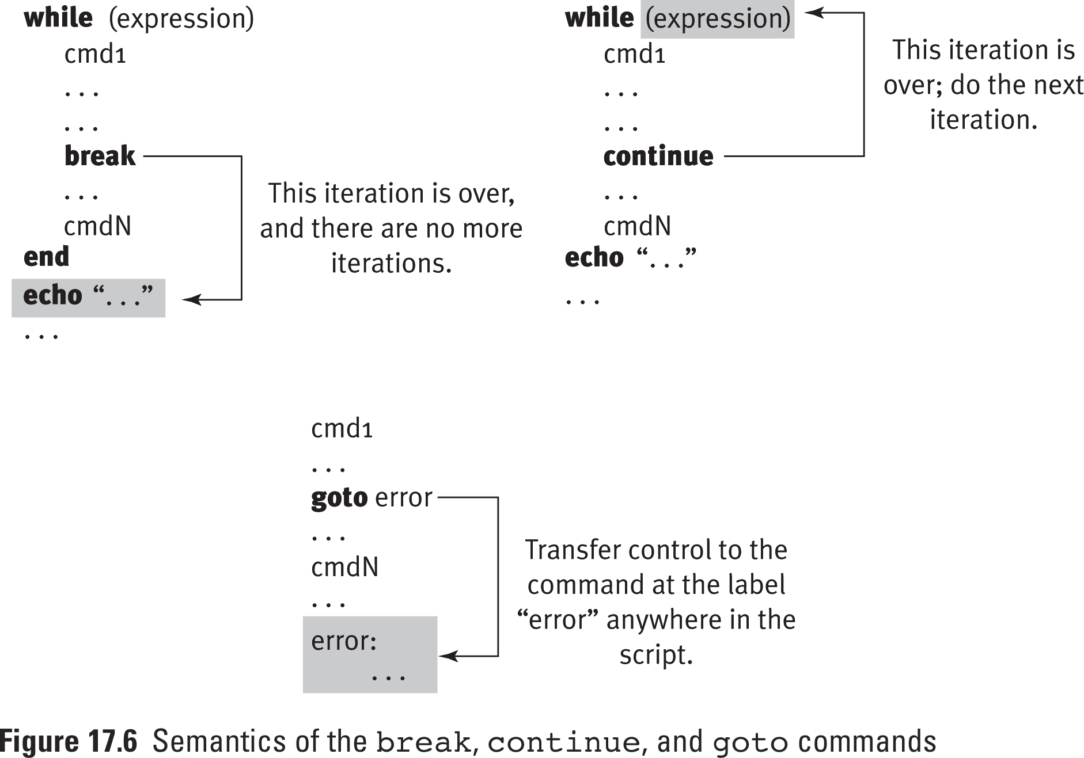
break, continue, goto

Slide 55
Debugging Shell Programs
The C shell programs can be debugged by using the –x and –v options of the csh command.
This allows viewing the commands in the user’s script after the variable substitution but before execution.
Use the following as the first line:
#!/bin/csh -xv

